Slide 1
Interfacing DAC with 8051
Engr. Shahzada Fahim Jan

Slide 2
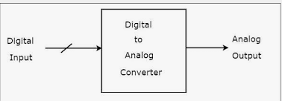
DAC (Digital to Analog Converter) is widely used to convert digital pulses to analog signal voltage or current.

Slide 3
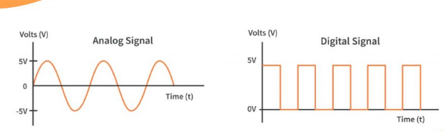
Analog:
Analog signals are a type of signal sent in a continuous wave. These waves can vary in both amplitude and frequency.
Digital:
Digital signals are signals that are represented in discrete values.

Slide 4
Resolution:
The amount of changes in the output voltage for every single change of the LSB of the digital input.

Slide 5
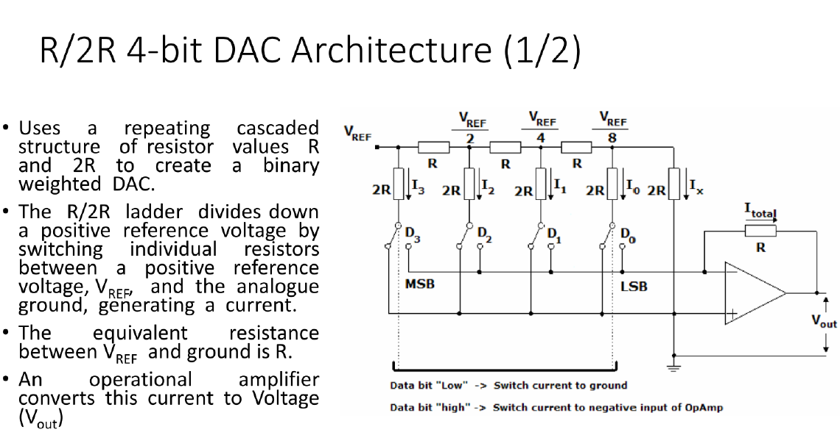

Slide 6
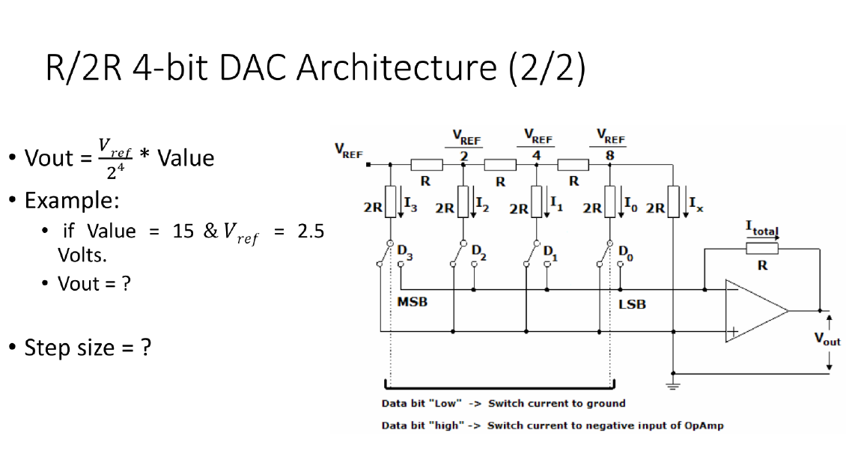

Slide 7
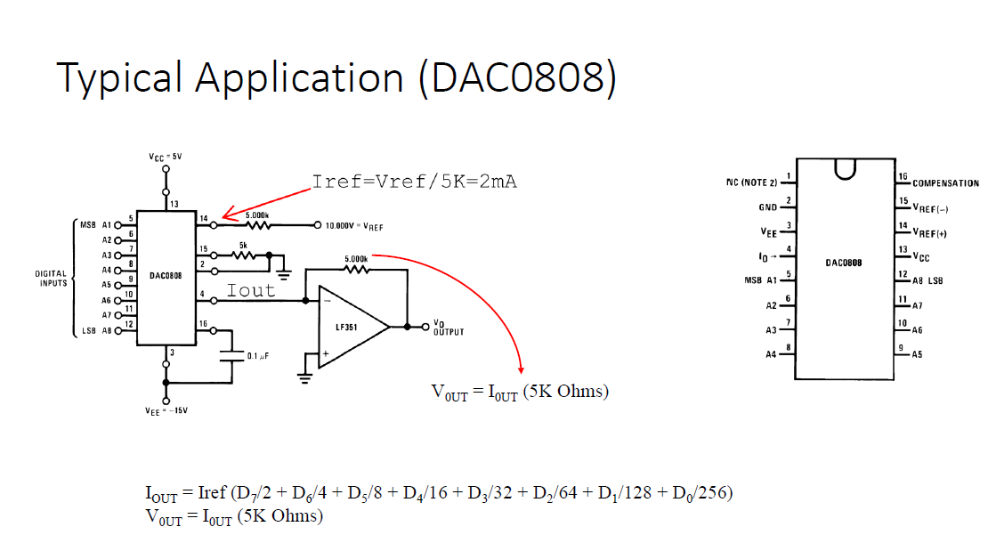

Slide 8
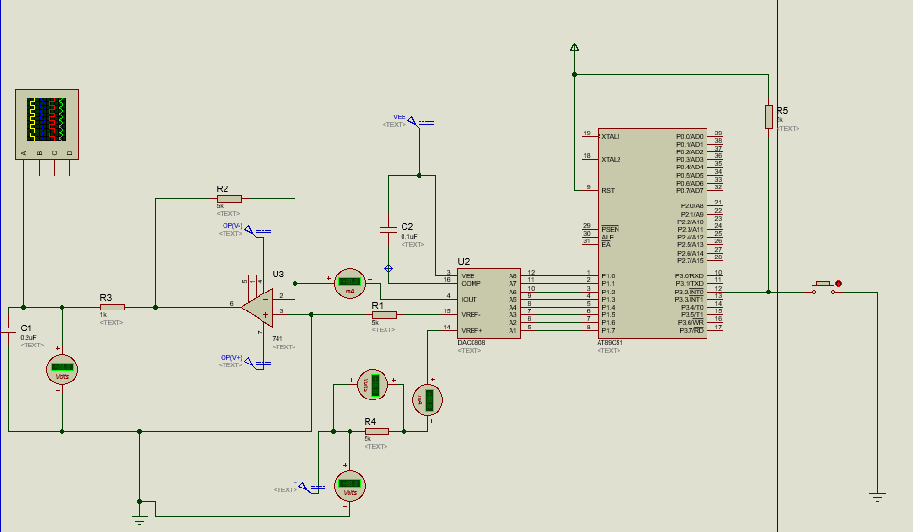

Slide 9
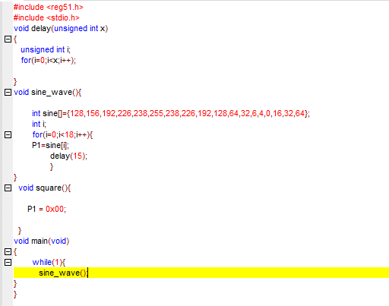

Slide 10
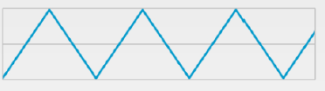
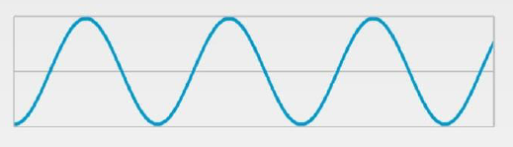
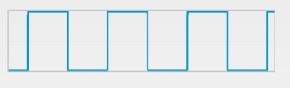
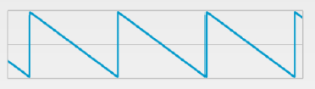
TASK
Generate the following waveform

Slide 11
You can use a button, when pressed once then generate triangular wave, when pressed again generate the square wave and so on.
Use Port-interrupt for button detection.

